Slide 1
Programming with Lab C#
In the name of Allah, most gracious and merciful
Lecture – 3
Class, object

Slide 2
What is class
Dictionary meaning:
a set of things having some attributes in common
Example: Human

Slide 3
Class
Animal Class: Car Class:
eyes; color;
legs; manufacturer;
head; length;
canWalk( ); speed( );
canEat( );

Slide 4
What is object
Object means: person or thing
Anika Fahim Mina Raju
Cat Lion Zebra Horse
Mango Papaya Orange Grape
Toyota Audi BMW Benz
Circle Triangle Square Oval
Potato Tomato onion Carrot
Burger Pizza Rice Bread

Slide 5
Class and Object
Object: Class:
Anika Fahim Mina Raju Person
Cat Lion Zebra Horse Animal
Mango Papaya Orange Grape Fruit
Toyota Audi BMW Benz Car
Circle Triangle Square Oval Shape
Potato Tomato onion Carrot Vegetable
Burger Pizza Rice Bread Food

Slide 6
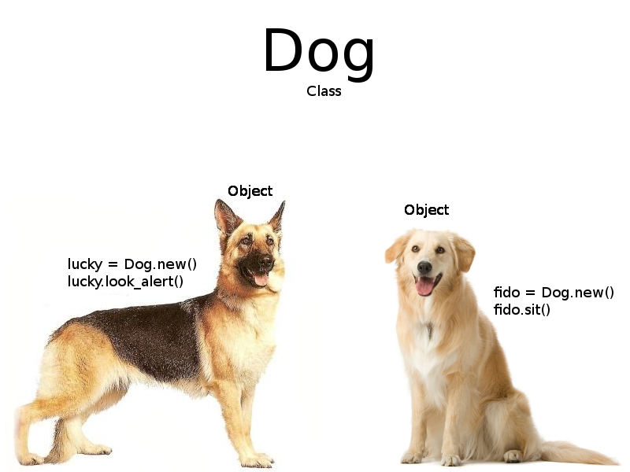
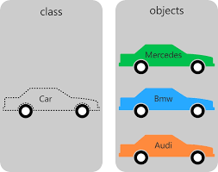
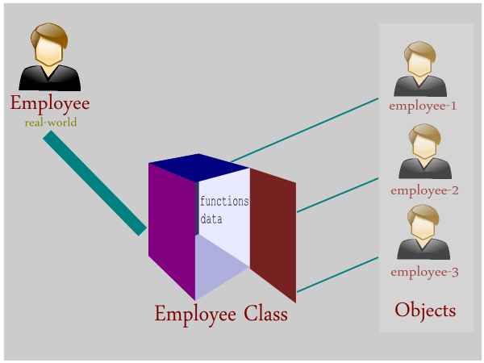
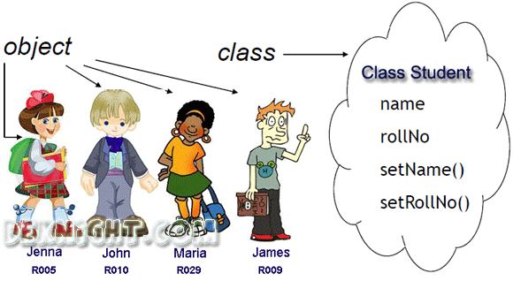

Slide 7
What is class in java
a class is a template for an object
class keyword
class Class_name
{
}

Slide 8
How to declare a class
class Human
{
}
class Car
{
}

Slide 9
How to declare a class
namespace practice{
class Human
{
}
class Program{
public static void main (String[] args){
}
}
}

Slide 10
What is object in java
An object is an instance of a class
- What is an instance???
Object declaration:
Class_name instance = new Class_name( );

Slide 11
Declare Objects in java
Animal A1 = new Animal( );
Animal cat = new Animal( );
Animal dog= new Animal( );
Human H1 = new Human( );
Human Zahid = new Human( );
Human Fahim = new Human( );

Slide 12
How to declare class and object
namespace practice{
class Human
{
}
class Program{
public static void main (String[] args) {
Human Zahid = new Human( );
}
}
}

Slide 13
'new' operator?
The 'new' is an operator in java which is responsible for the creation of new object or we can say instance of a class. (Actually, it dynamically allocates memory in the heap with the reference by pointing from the stack.)

Slide 14
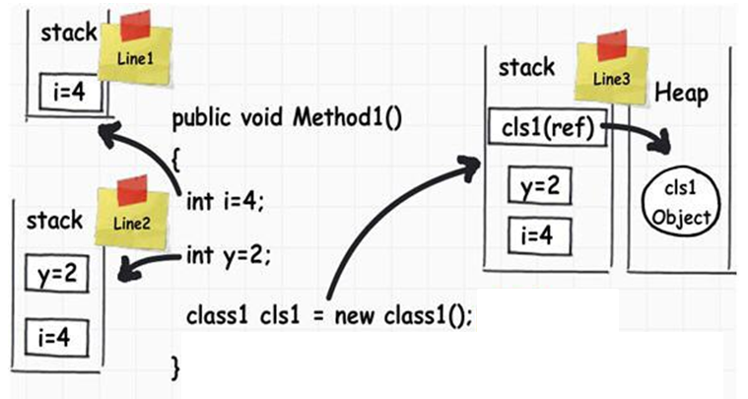
'new' operator?

